Slide 1

Database Management and Practise
Group D
Kobiljon / Anvar / Jasurbek / Asliddin / Olim

Slide 2

Hospital Rapid report helper
Agenda
Goals
Task description
Database requirements

Slide 3
Goals
1. To automate report creation process so that doctors prepare reports faster and more easily which leads to more patients to be diagnosed in a day.
2. To save information about facilities, report-making process, and customer satisfaction process in order to make it efficient and make precise decisions.

Slide 4

What is the problem?
Radiologists who make prognosis based on test results, such as MRI, CAT scan results repeat most of their comments over and over again by typing. It is time-consuming and it reduces the ability of doctors to make prognosis faster.

Slide 5

Task description:
This database includes 9 tables and it assists doctors or radiologist make reports faster and more conveniently. Because results are classified and individual comments done by doctors are rare so the application should automate this process.

Slide 6
Doctor
ID
Patients
ID
Name
Session
lD
Date
Name
Foreign key as illnesses
Facility
Doctor
Patients
Rooms
Patients
ID
Name
Report
ID
Content TEXT
Illness
ID
Name
BodyPart
ID
Name
Create DATETIME
Illness id
Session id
Session doctor
Session patients id
Session room id
Stage
Metastation
LymphNodes
Illness
Room
ID
Name
Facility
ID
Name
Feedback
ID
Content Text
Number
Model
Available
Room ID
Created DateTime
Session id
Session doctor
Session patients
Session room

Slide 7
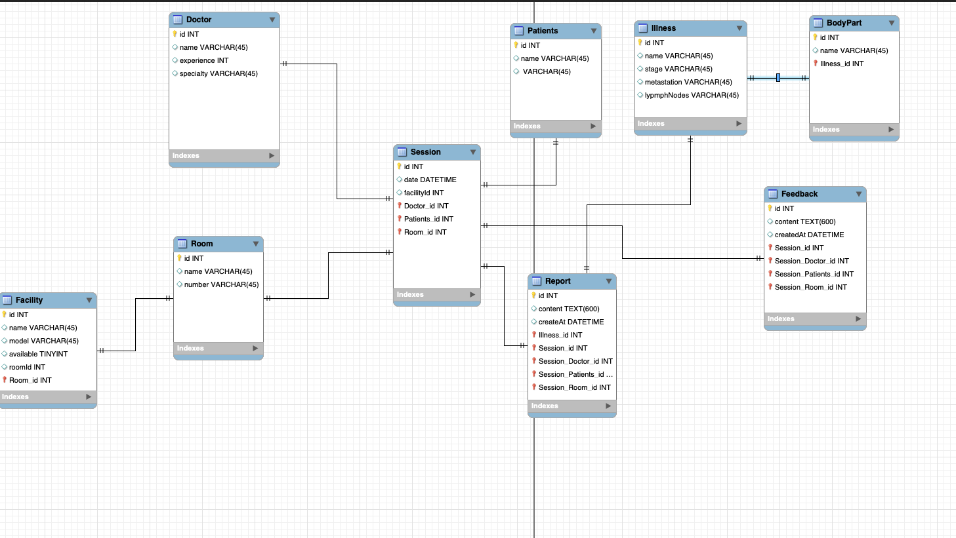

Slide 8

Thank you !

